Slide 1
Getting started with yolov5 for inference
David Novikov

Slide 2
Agenda
Overview of ML pipeline
Problem statement
Deployment
Setup
Tutorial

Slide 3
Overview and Problem Introduction

Slide 4
ML pipeline
Data
Model
Define Problem
Define Solution
Training
Deploy
What?
Why?
Appropriate?
How?
Integration
Today
Evaluate - Redo

Slide 5
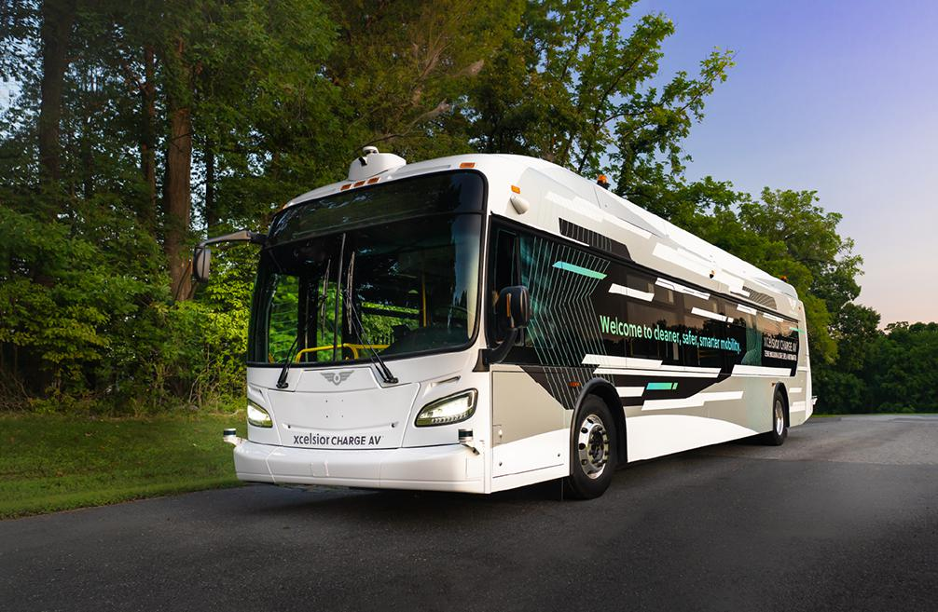
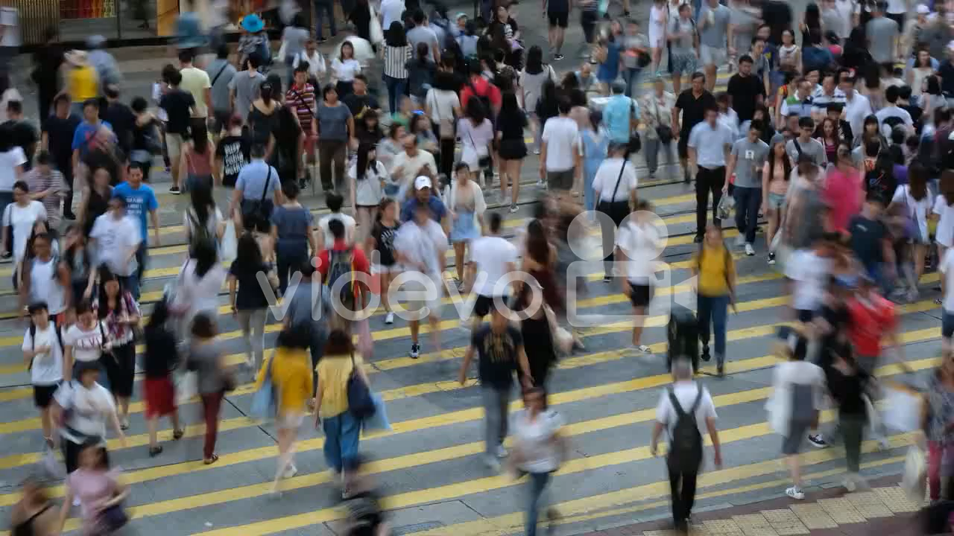
Problem Statement
You work for mayor’s office
New busline
No drivers – fully autonomous
Problem: Buses can’t detect if people are crossing intersection
Your job to solve in the next ~30 min

Slide 6
What are we doing today?

Slide 7

Deployment
Today we will be using yolov5 as the ML part of our solution
We will focus on integrating out of the box ML models into a solution
Why Yolov5?
Easy to use
Python friendly
Pretrained models

Slide 8
Setup and Tutorial

Slide 9
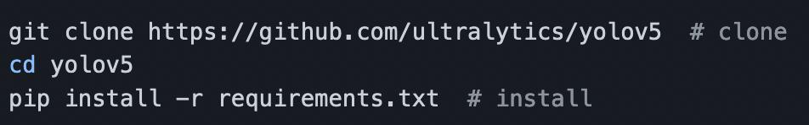
Setup
Open terminal
Set up a new folder
Set up new python environment (python venv, conda, etc.) with python 3.8
Clone this repo and cd into it
https://github.com/DavidNovikov/Yolov5Tutorial
Clone yolov5 from github
https://github.com/ultralytics/yolov5

Slide 10
Tutorial!
Open starterCode.py in ide of choice
Run the code once
Step through existing code
Add lines for decision boundary
Add math for decision boundary
Add logic to determine if intersection is safe
Add colors and text

Slide 11
References
https://imageio.forbes.com/specials-images/imageserve/60133a2ba868b9dc5ec5f82d/0x0.jpg?format=jpg&width=1200
https://github.com/ultralytics/yolov5

